Slide 1
Vote Centers: The Future of California Elections?
December 11, 2014
Presented to the CACEO
New Law Conference

Slide 2
Voting Systems Assessment Project
Seeking to modernize Los Angeles County’s aging voting system
Developing a new voting system that is centered on the needs of Los Angeles County voters
Exploring new ways of administering elections

Slide 3
Research Objectives
What are vote centers and which jurisdictions use them?
What effect have vote centers had on elections?
What would the implementation of vote centers look like in Los Angeles County?

Slide 4
Methodology
This research involved legislative analysis, academic research and interviews with election administrators
As part of our research we developed comprehensive case studies on vote center models used in Colorado, Indiana, Texas, Nevada and Florida

Slide 5
What is a Vote Center?
A polling place at which any registered voter in the county may vote, regardless of their precinct
Vote centers are used in two ways
Early Voting Centers
Election Day Vote Centers (EDVC)

Slide 6
Early Voting Centers
Early voting centers are used during the early voting period
Popular in states that do not offer Permanent Vote By Mail
Ex. Ohio, Florida, Texas, Arizona etc.

Slide 7
Election Day Vote Centers
Election day vote centers replace traditional precinct based polling places
The number of voting locations offered is reduced

Slide 8
Benefits for Voters
Voter is empowered by the ability to choose the most convenient location and time
Vote centers are located in common destinations and public facilities that are well known and recognizable
Eliminates the possibility of an eligible voter showing up at the wrong location
Which reduces provisional voting rates!

Slide 9
Benefits for Administrators
Reduction in provisional voting!
Fewer locations to manage on Election Day
Reduces the voting equipment and staffing needs on Election Day
Fewer poll workers to recruit and train
Flexibility to focus on quality over quantity of poll workers

Slide 10
Potential Disadvantages
Some voters are resistant to change, especially those comfortable with local polling places
The distance to the voting location from home may increase for some voters
Increased dependence on technology
Not all voters welcome technology in the polling place

Slide 11
Vote Center Components
A voting system that can provide any eligible voter with their appropriate ballot style
An electronic poll book that can communicate with the voter registration database in real-time
Legislation permitting the use of vote centers

Slide 12
Providing Every Ballot Style
Los Angeles County regularly has well over 200 ballot styles
Potential solutions for providing voters with their appropriate ballot
DRE voting machines
Paper ballot on demand systems
Paper ballot marking device loaded with every ballot style

Slide 13
Electronic Poll Book
Electronic poll books are used in 30 states
Regulation varies from state to state
Some jurisdictions developed in-house solutions
Replace paper rosters
Solutions consist of software and COTS (tablets, laptops, etc.) or bundled products
Can be connected to central database or operated offline

Slide 14
Electronic Poll Book Benefits
Reduces printing costs and streamlines many post election processes
Speeds up the voter look up process and reduces mistakes
With a network connection can,
Monitor voting location status in real time
Track turnout statistics accurately
Retrieve and update any county-wide voter record

Slide 15
Potential Challenges
Costly to acquire software and hardware components
Compatibility with the existing statewide voter database
Data connectivity depending on state laws and regulations
Security against cyber threats
Malfunction can significantly impact an election

Slide 16
Experience to Learn From
2006 General Election Denver, Colorado
Major electronic poll book failures led to wait times of up to 3 hours
Between 18,000-20,000 voters left the polls because of the wait
“the ePollBook, developed exclusively for DEC… is of decidedly sub-professional architecture and construction and appears never to have been tested in any meaningful manner by either the vendor or by the DEC.”

Slide 17
Early Voting Legislation
Legislation already exists permitting early voting centers in California
Early voting dates and locations are largely determined by counties
Vote-by-mail constitutes the vast majority of early voting in California

Slide 18
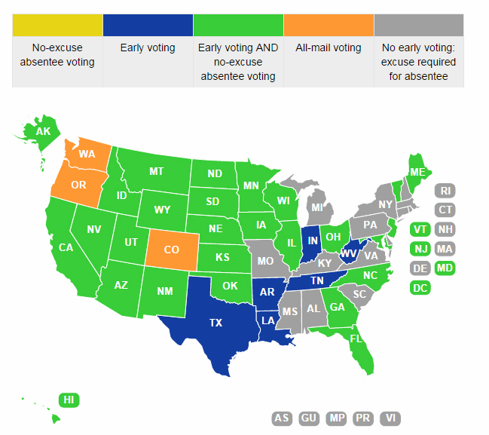
Early Voting Map
National Conference of State Legislatures

Slide 19
Clark County, Nevada
852,413 active registered voters
Early voting begins E-17 and ends E-3
88 early voting sites with 25 open each day during the 2014 election
Offered long term (5-14 days) and short term (1-7 days) early voting sites
51.2% of registered voters voted early and early voting represented 63% of the turnout

Slide 20
Origin of EDVC
Election day vote centers began in Larimer County, Colorado
EDVC were created in response to changes in election administration brought by HAVA
Colorado has since moved to all mail voting, and now operates Voter Service and Polling Centers on Election Day

Slide 21
Transition to EDVC
Election day vote centers operate similarly to early voting centers
Success with early voting centers makes the implementation of EDVC easier
Travis County, Texas (652,463 RV)
Used their early voting framework
Used same technology and location type
Early voters were less attached to a polling place

Slide 22
EDVC Legislation
11 states have passed EDVC legislation
Only Texas and Indiana use EDVC for general elections
Support of elected officials and stakeholders at the state level is critical
EDVC are codified as an option, not a requirement
Sets the rules and conditions for the use of EDVC
Details the implementation method
Usually through a controlled pilot program during an odd year election

Slide 23
Number of Voters per Vote Center
Texas
5,000 voters for precinct based polling places
Counties can reduce their voting locations by 35%
Up to 7,692 voters per vote center
Indiana
1,000 voters for precinct based polling places
Up to 10,000 voters per vote center (modeled after Colorado)

Slide 24
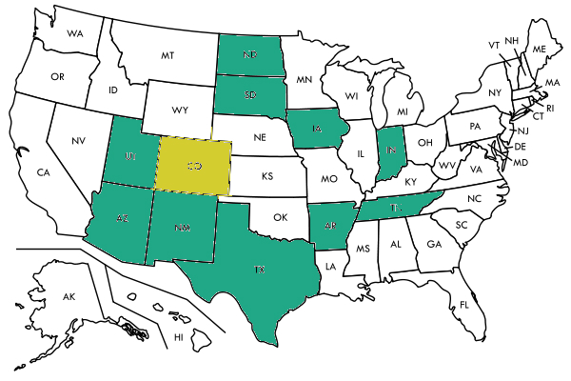
Legislative Map
Indiana
Texas
Colorado*
Tennessee
New Mexico
Arizona
Utah
S. Dakota
N. Dakota
Iowa
Arkansas

Slide 25
Legislative Milestones
2004 — Colorado (SB 153).
2005 — Texas (HB 758)
2006 — Indiana (HB 1011).
2008 — Iowa (HF 2620).
2010 — North Dakota (HB 1378), South Dakota (SB 101), Tennessee (SB 3687) and Texas (HB 719)
2011 — Arizona (HB 2303), Indiana (SB 32), New Mexico (SB 337), Tennessee (HB 1268), Texas (HB 2194) and Utah (HB 130)
2013 — Arkansas (HB 1875)

Slide 26
Legislative Findings
EDVC legislation has been passed by both Democrat and Republican state legislatures
EDVC legislation has remained outside of the partisan discussion
It’s not politically charged in the way that early voting period and voter identification are
Strong support for EDVC from election administrators

Slide 27
Key Findings
Academic research has shown EDVC has a positive or neutral impact on turnout
Fiscal study in Indiana shows major Election Day savings
The number of EDVC counties is growing in Texas and Indiana
All states with EDVC use early voting centers
Success and history of early voting makes the transition to EDVC easier

Slide 28
Best Practices
Stakeholders must be engaged throughout the transition to early voting centers and EDVC
Voter education and outreach is critical to a successful implementation of early voting centers and EDVC
Rolling out too many new components at once is risky
This process will take time, and it may take multiple cycles to develop a mature program

Slide 29
Vote Centers in California
Early voting center rules are already in place
Use is determined by capabilities and needs of the jurisdiction
Provide an additional option for voters
Legislation will be required for the use of EDVC
Determine the number of voters per vote center
Create a pilot program

Slide 30
Questions for California
How many vote centers do we require?
1,000 voters per precinct polling places
Is there a right number for every county?
What will California’s pilot program look like?
Who will participate?
Which counties can support EDVC?

Slide 31
Special Thanks
National Conference of State Legislatures
Indiana Secretary of State
Travis County, Texas
Larimer County, Colorado
Elkhart County, Indiana
Clark County, Nevada
California Association of Clerks and Election Officials

